Slide 1

CSS Grid
M3-03
Participate! The more engagement the better! You are NEVER interrupting me!

Slide 2
Objectives
CSS Variables
CSS Grid
Responsive Design

Slide 3
CSS Variables
CSS Variables work similar to variables in Java. They allow for values to be assigned to a reusable variable name.
Variables are created and assigned to the :root of the document.
:root { --top-row-height: 120px; --gutter: 20px; }
Variables can then be used in the CSS using the var() method with the variable name
p { height: var(--top-row-height); }

Slide 4
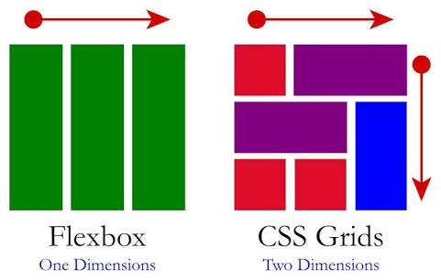
CSS Grid and Flexbox

Slide 5
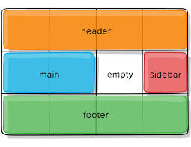
CSS Grid
CSS Grid Layout is a 2-dimensional system, meaning it can handle both columns and rows.
You work with Grid Layout by applying CSS rules both to a parent element (which becomes the Grid Container) and to that element’s children (which become Grid Items).

Slide 6
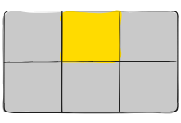
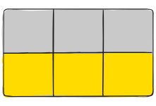
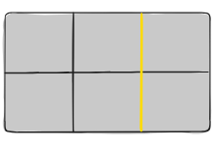
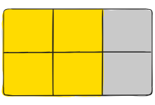
Grid Terminology
Grid Cell
The space between two adjacent row and two adjacent column grid lines. It’s a single “unit” of the grid.
Grid Track
The space between two adjacent grid lines. You can think of them like the columns or rows of the grid.
Grid Area
The total space surrounded by four grid lines. A grid area may be composed of any number of grid cells.
Grid Container
The element on which display: grid is applied.
Grid Item
The children (i.e. direct descendants) of the grid container.
Grid Line
The dividing lines that make up the structure of the grid. They can be either vertical (“column grid lines”) or horizontal (“row grid lines”) and reside on either side of a row or column.

Slide 7
Display
grid-template-columns
Defines the element as a grid container and establishes a new grid formatting context for its contents.
Values:
grid – generates a block-level grid
inline-grid – generates an inline-level grid
Defines the columns of the grid with a space-separated list of values. The values represent the track size, and the space between them represents the grid line
grid-template-columns: 4fr 1fr 2fr;
Columns can be a length, a percentage, or a fraction of the free space in the grid (using the fr unit)
Fractional Units ( fr ) is the preferred unit to allow the grid to correctly adjust for different display sizes.
.container {
display: grid | inline-grid;
}

Slide 8
grid-template-areas
grid-area
Grid template areas is where a developer can set up names for different sections of the defined grid. grid-template-areas is defined as a series of strings. Each string will have as many sections as there are columns defined and there will be a row created for each string in the sequence.
Grid Areas are applied to the Grid Items and identify the area of the grid the element should be displayed in.
div.header {
grid-area: header;
}
div.main {
grid-area: main;
}
div.sidebar {
Grid-area: sidebar;
}
grid-template-areas:
"header header header"
"main . sidebar"
"footer footer copyright";

Slide 9
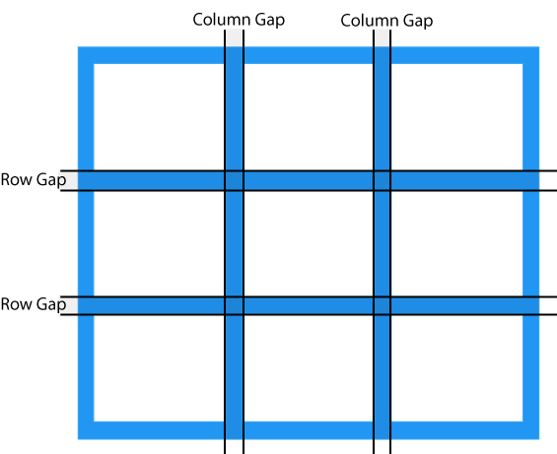
Grid Gap
Grid Gap is area between the grid tracks.
It can be defined as the gap between columns, the gap between rows, or for both columns and rows. Grid gap is applied to the container.
Grid Gap adds space between columns and rows, but not on the outer edges of the grid.
grid-column-gap: 10px;
grid-row-gap: 15px;
grid-gap: 20px;

Slide 10
CSS Grid Links
CSS Tricks: Complete Guide to Grid comprehensive documentation with examples
CSS Grid Garden game to learn Grid
Layoutit! grid layout tool
Mozilla Grid Tutorial

Slide 11
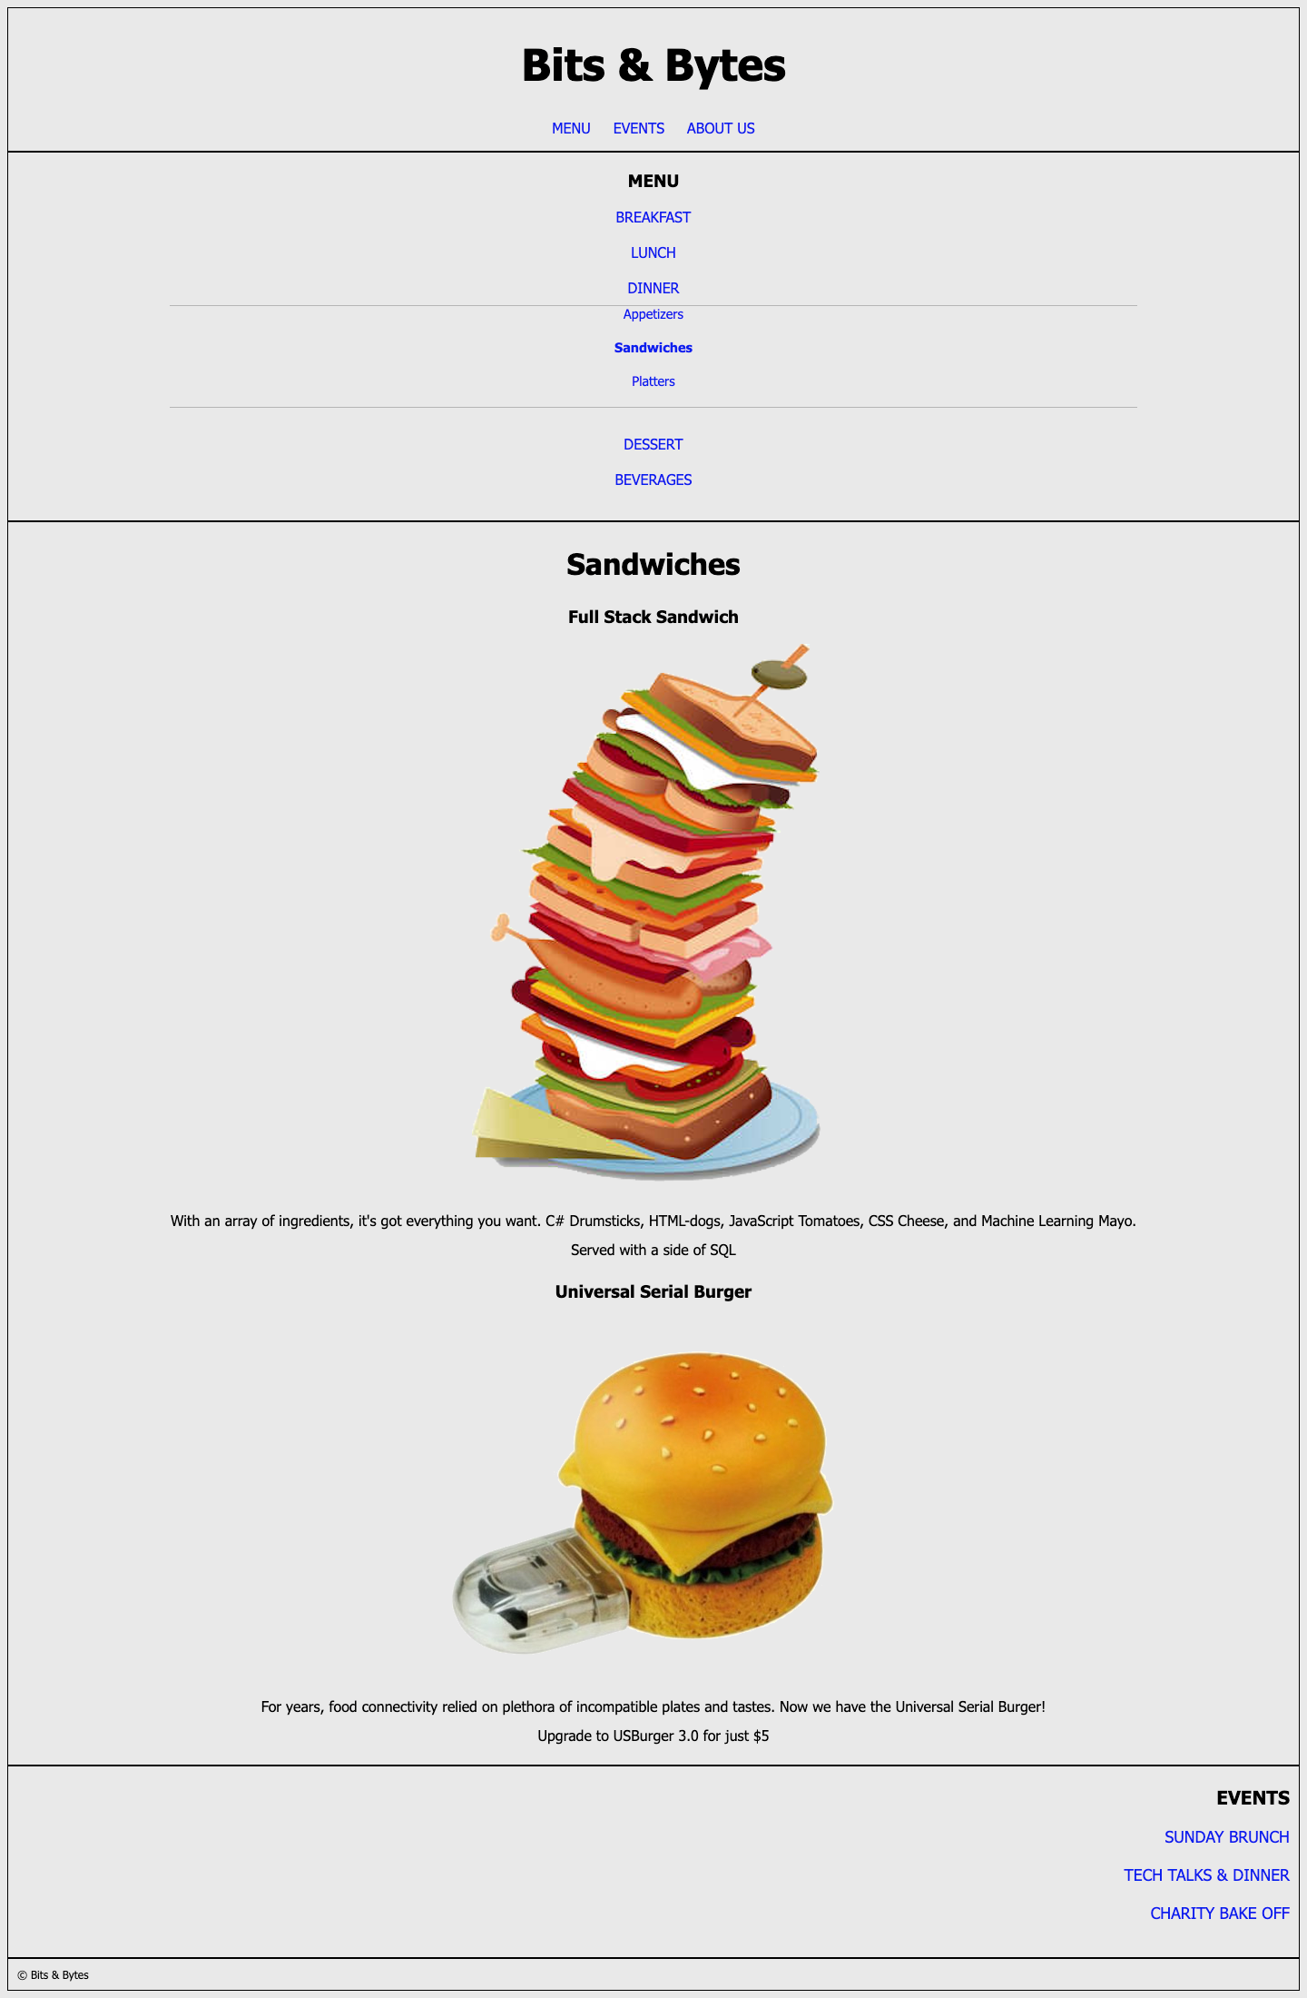
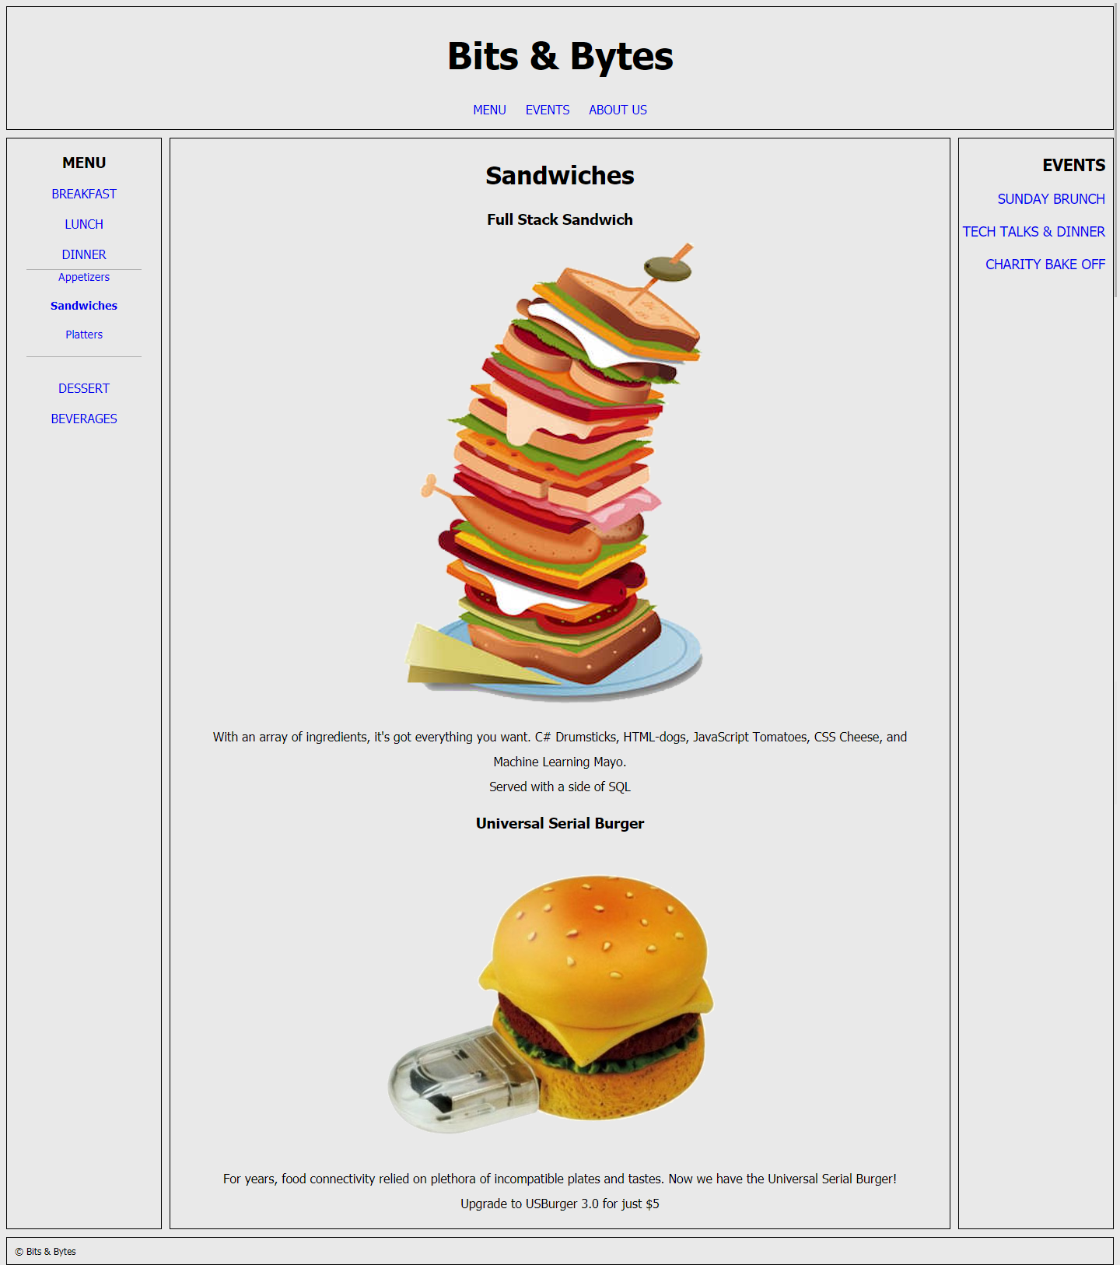

Slide 12


Responsive Design
Design for mobile first
Avoid fixed dimensions
Design for specific devices
phone
tablet
computer
Prioritize content differently for different devices
Use responsive sizing like em, rem, vh, and wh instead of absolute sizing like px
Use either min-width/height or max-width/height, but not both

Slide 13
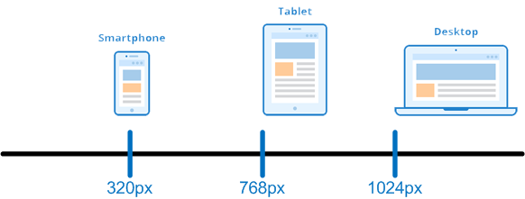
CSS Media Query
Creates conditional CSS that will be applied for different sizes of viewports, for example css that will be applied to a phone and different CSS that will be applied to a computer.
Done by creating breakpoints where the CSS being applied changes
Documentation
Common Sizes:
Small (smartphones): 320px
Medium (tablets): 768px
Large (computer): 1024px
Media Query Examples:
@media only screen and (min-width: 768px) { .. }
@media only screen and (orientation: landscape) { .. }
@media (min-width: 700px) and (orientation: landscape) { .. }

Slide 14
/* Extra small devices (phones, 600px and down) */
@media only screen and (max-width: 600px) {...}
/* Small devices (portrait tablets and large phones, 600px and up) */
@media only screen and (min-width: 600px) {...}
/* Medium devices (landscape tablets, 768px and up) */
@media only screen and (min-width: 768px) {...}
/* Large devices (laptops/desktops, 992px and up) */
@media only screen and (min-width: 992px) {...}
/* Extra large devices (large laptops and desktops, 1200px and up) */
@media only screen and (min-width: 1200px) {...}

Slide 15
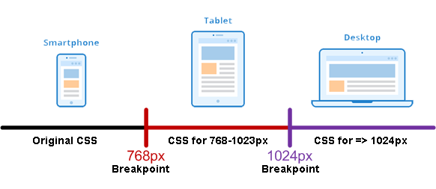
Breakpoints
Breakpoints are pixel sizes where the CSS “breaks” and changes to a different media query to adjust the presentation of the site.
Design for the smallest size first, then create a breakpoint for each device size where you want to change the layout.

Slide 16
HTML Viewport Meta Tag
Added in HTML5 - instructs the browser how to control page dimensions
Required for mobile/tablets to properly size, resize, and zoom a page
Current recommendation is to keep it minimal and use MediaQuery for sizing, unless you are working for an IOT (Internet of Things) application
Added to the <head> of an HTML document, and will almost always be the following:
<meta name="viewport" content="width=device-width, initial-scale=1">

